Slide 1


Step-Climbing Wheelchair
GROUP MEMBERS :
AKHIL S KUMAR (927622BME001)
C.ANTONY RUFUES (927622BME002)
S.ARAVINDH (927622BME003)
GUIDED BY
DR.M.BALAKRISHNAN
PROFESSOR

Slide 2
ACKNOWLEDGEMENT
I would like to express my special thanks of gratitude to Dr. M Balakrishnan for guidance and support in the project.
who gave us the golden opportunity to do this project on the topic
“Stair Climbing Wheelchair “
which also helped us in doing a lot of research and we came to know about so many new things

Slide 3
AGENDA
Introduction
Important futures of our wheelchair
2D Diagram
Working
Major components
Application
Cost estimation
Conclusion

Slide 4
INTRODUCTION
Many people are suffering of temporary or permanent disabilities due to illnesses or accidents.
For cases of difficult or impossible walking, the use of a wheelchair is becoming essential.

Slide 5
IMPORTANT FUTURES OF OUR WHEELCHAIR
Some Important futures of our wheelchair are: Movable seat Height adjustable Easy used to lift in the stairs Seating is designed for restroom purposes Easily movable

Slide 6
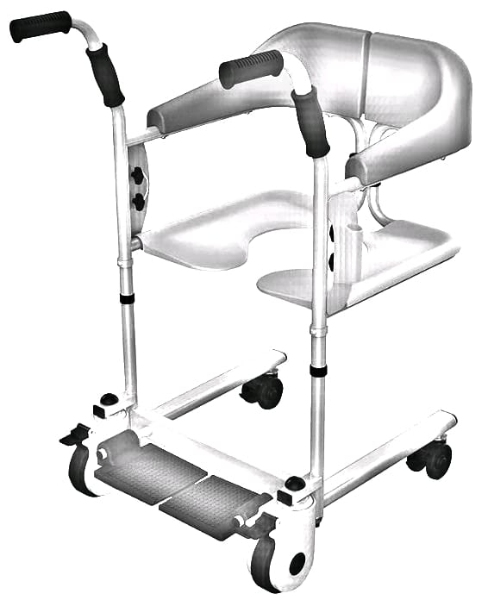
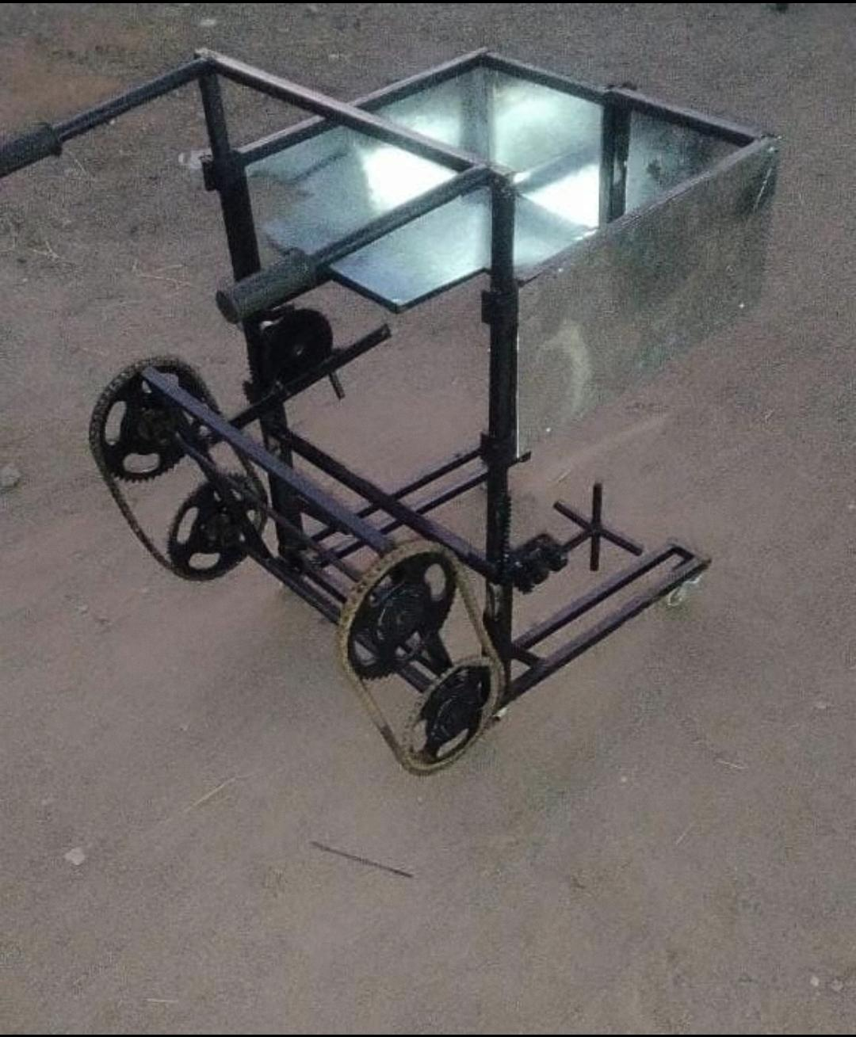

Slide 7
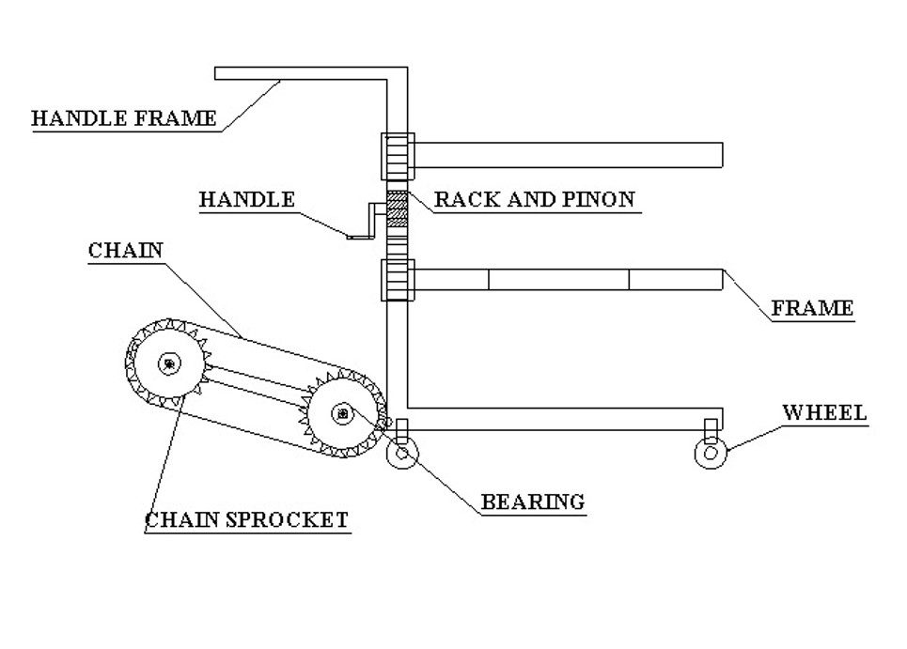
2D DIAGRAM

Slide 8
WORKING PRINCIPLE
Two rovers have been placed at the rear ends which helps to move in steps.
This wheelchair is totally run by Man-power that is there is no need of motors .
Rack and pinion mechanism is used to adjust the height of the wheelchair.
The wheelchair is made as user friendly so seat are adjustable that is it can be opened and closed according to the users wish.
Bearing helps the chain sprocket to rotate thus makes the operator easy to climb the stair with comfort and simple manual effort.

Slide 9
MAJOR COMPONENTS
SOME MAJOR COMPONENTS ARE :
Sheet metal
Wheel
Frame
Shaft
Metal Strip
Hand Lever
Chain Sprocket

Slide 10
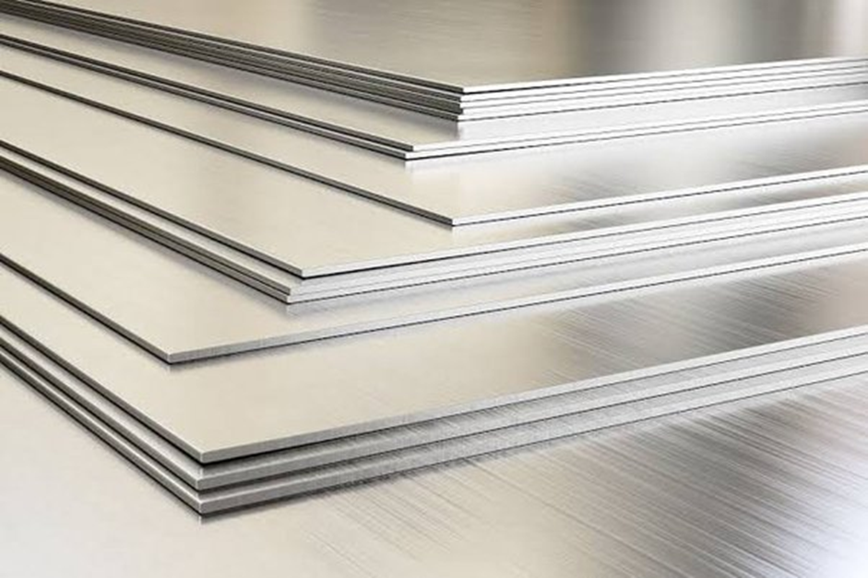
SHEET METAL
SHEET METAL IS USED IN AUTOMOBILE INDUSTIRES TO BUILD THE OUTER BODY OF THE OBJECT.
THE SPECIFICATION OF THE SHEET METAL WE USE IN OUR PROJECT ARE:
Material - Mild steel
Size - 40*15cm
Thickness - 1mm

Slide 11
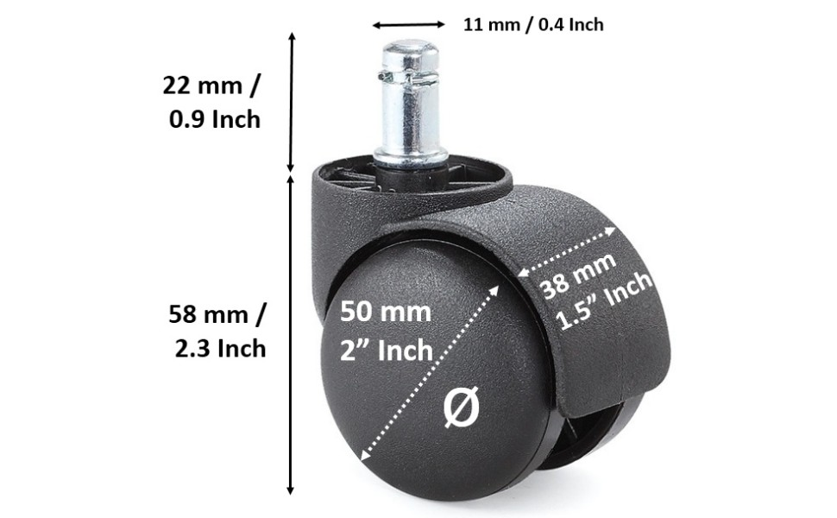
WHEEL
Wheels allow heavy objects to be moved easily facilitating movement or transportation while supporting a load, or performing labor in machines.
Wheel diameter: 50mm/2 inch
Total height : 80mm/3.2 inch

Slide 12
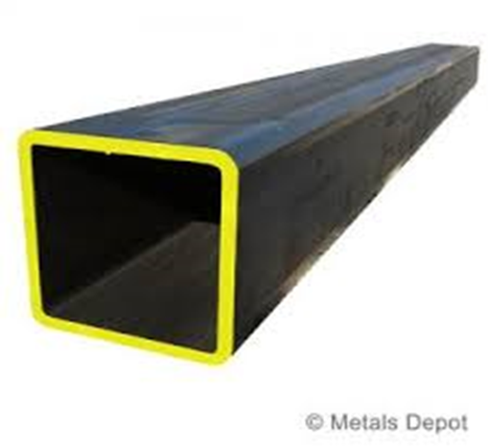
FRAME:
The metal frame is generally made of mild steel bars for machining, suitable for lightly stressed components.
Specifications:
Material - Mild steel
Thickness - 1mm

Slide 13
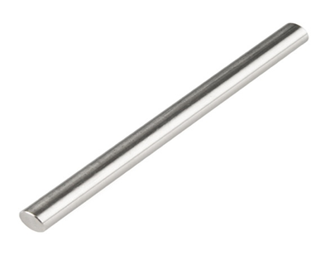
SHAFT:
Shaft is a common and important machine element. It is a rotating member, in general, has a circular cross-section and is used to transmit power.
Specifications:
Shaft diameter: 12mm
Material : Mild steel
Length : 26 inch

Slide 14
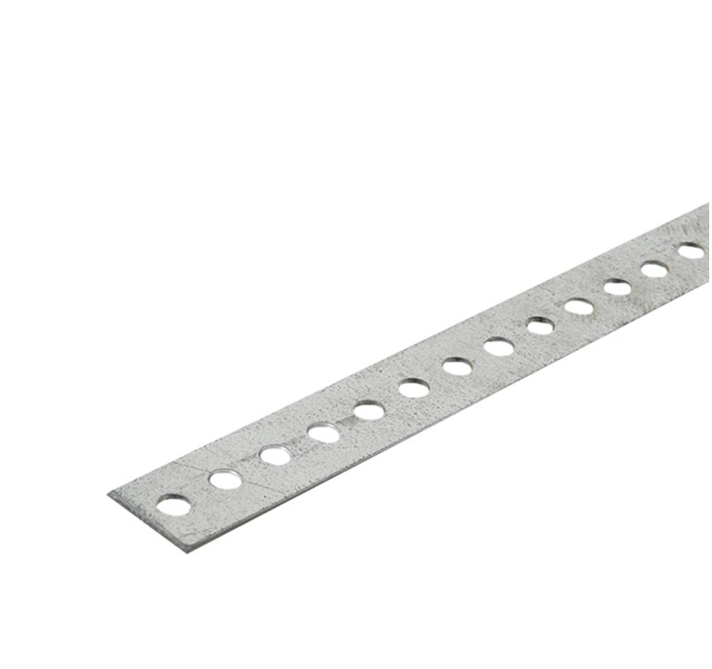
METAL STRIP
A metal strip is a stainless steel which is commonly made of ferrous metal,
It consist of holes which is used to lock the hight level.
1 Metal strips are used.

Slide 15
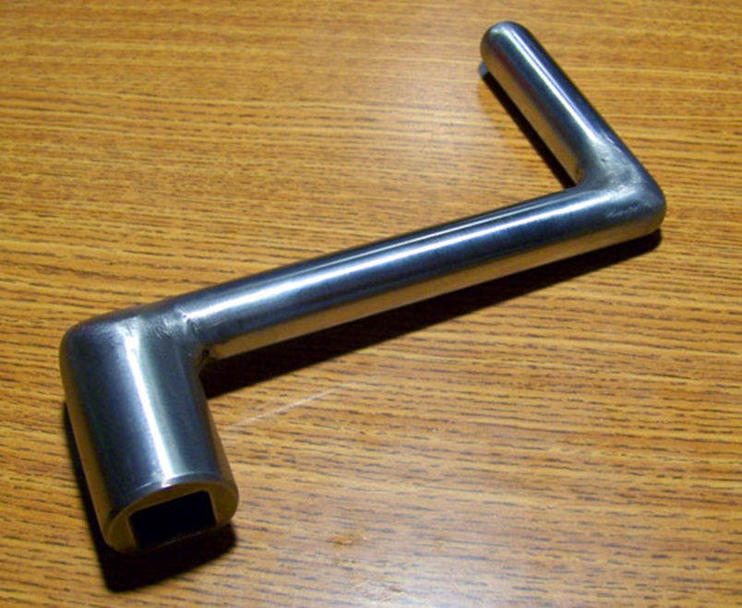
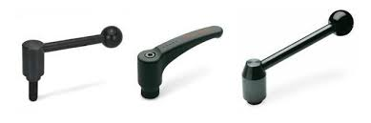
HAND LEVER
A handle lever is attached to a piece of machinery and which is used to push or pull in order to operate the machinery

Slide 16
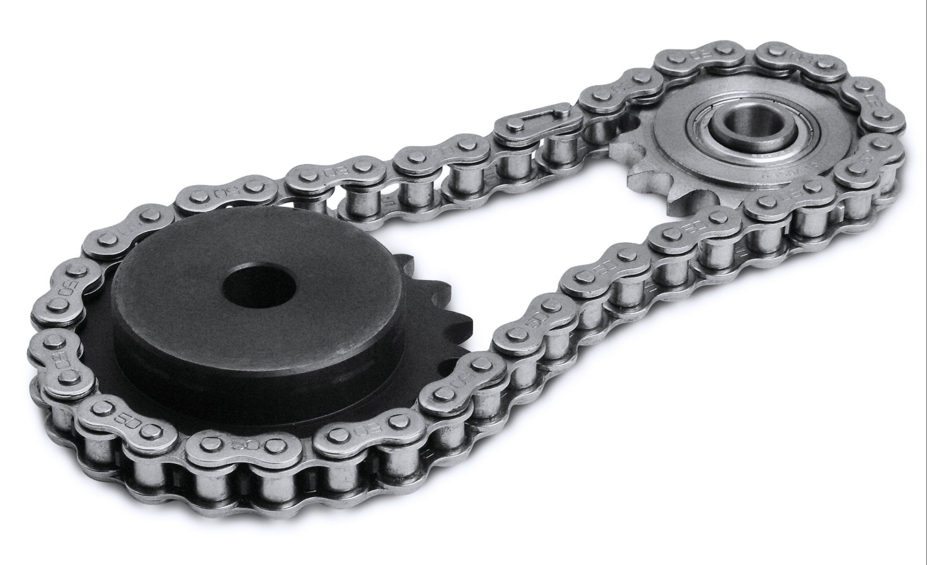
CHAIN SPROCKET
Chain sprocket is a tool used to transmitting mechanical power from one place to another. It is often used to convey power to the wheels of a vehicle, particularly bicycles and motorcycles
Specifications:
Material : High Carbon Steel
Pitch : 12.7mm
Width : 30mm
Teeth length : 16mm

Slide 17
APPLICATION
The applications of stairs climbing wheel chair are
It is used for physically challenged people.
It is used travel from one place another in structured or unstructured environments.
It may be used in hospital for patients

Slide 18
COST ESTIMATION
S.No | DESCIRPTION | RATE
1. | CHAIN SPOCKET | 700
2. | SHEET METAL | 500
3. | LABOUR | 500
4. | FRAME | 600
5. | SHAFT | 800
6. | METAL STRIP | 1000
7. | HAND LEVER | 900
8. | TOTAL | 5000

Slide 19
CONCLUSION
As paper conclude that Disabled people are increasingly able to lead an independent life and play a more productive role in society with the help of stair climbing wheelchair.
Maximum payload was 80 kg.
It can travel on rough as well as flat surface

Slide 20


